Slide 1

Subway Surfers Leaderboard Analysis
Gaming Industry
- Pratyush Majumdar

Slide 2
Objective
To analyze and uncover insights from the Subway Surfers speedrun leaderboards, focusing on various metrics such as the fastest completion times, top-performing players, platform preferences, and demographic trends within the speedrunning community.
This analysis aims to provide valuable insights into player behavior and trends, helping to understand the dynamics of the Subway Surfers speedrunning community.

Slide 3
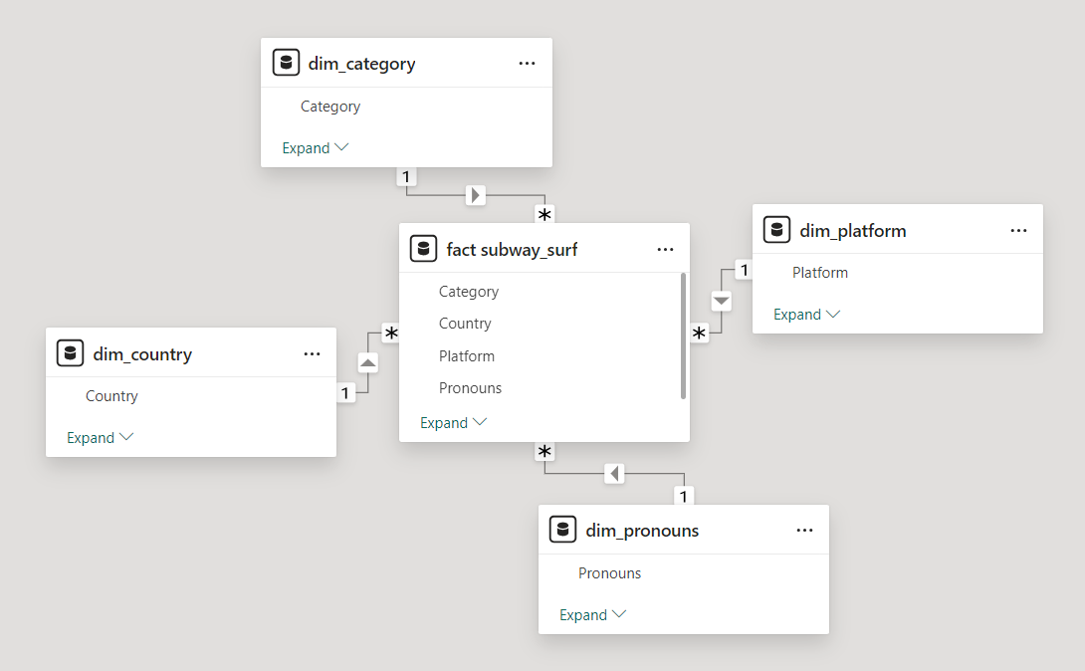


Data Model and Technology Used

Slide 4
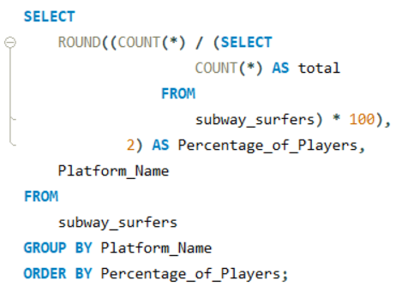
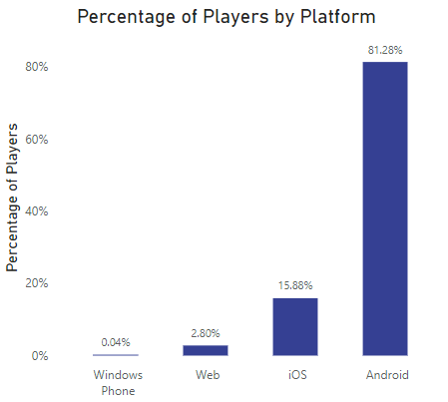
Insights
1) Calculate the percentage of players for each platform.

Slide 5
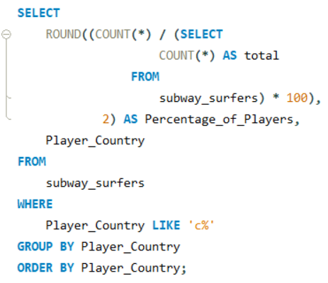
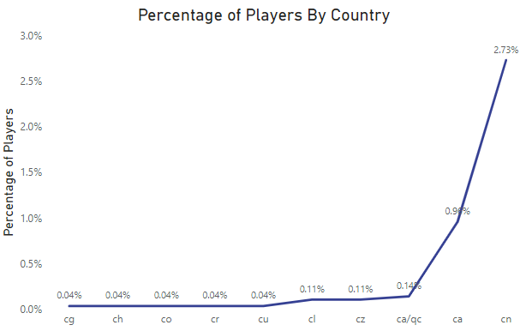
2) Calculate the percentage of players for each country whose name starts with ‘c’.

Slide 6
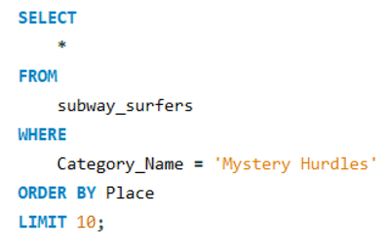

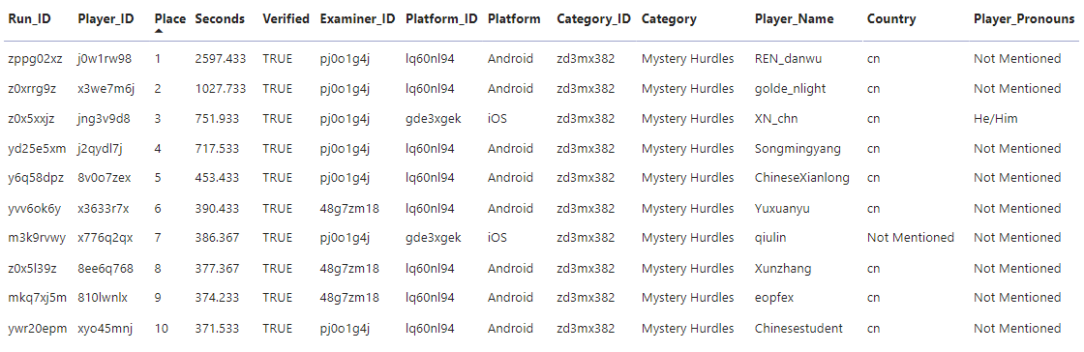
3) Identify the top 10 players for ‘Mystery Hurdles’ category.

Slide 7
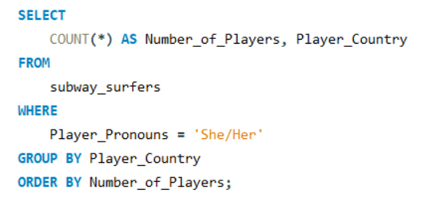
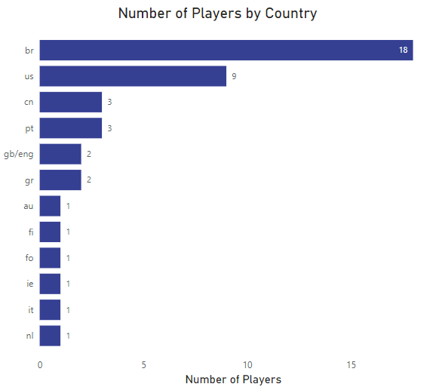
4) Identify the number of players for each country whose pronouns are ‘She/Her’.

Slide 8
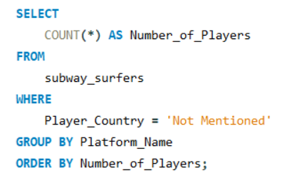
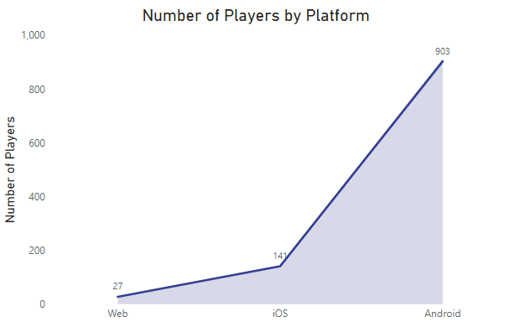
5) Identify the number of players for each platform who have not mentioned their country name.

Slide 9
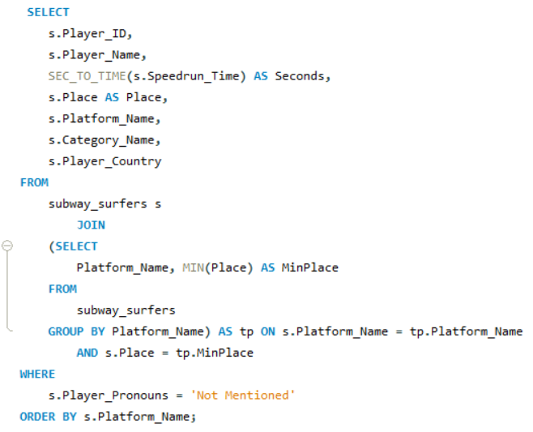

6) Identify the top performers for each platform who have not mentioned their pronouns.

Slide 10
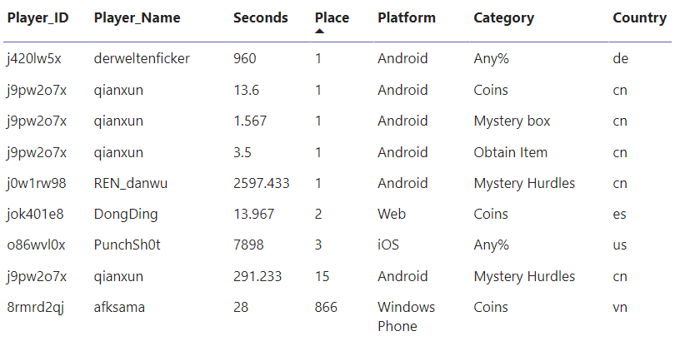

Slide 11
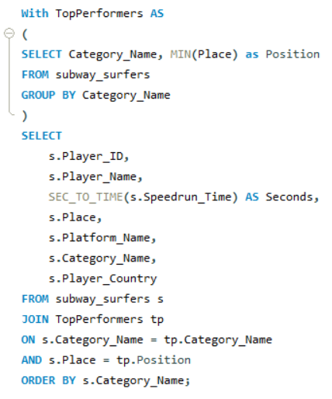
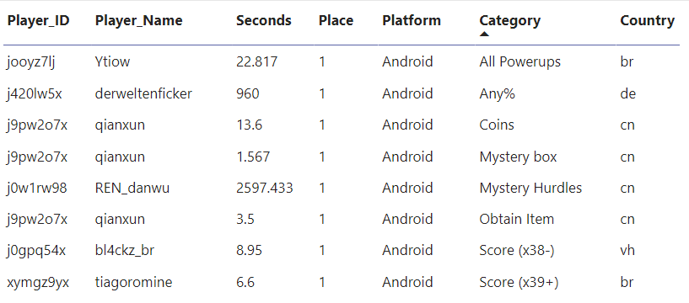
7) Identify the top performers for each category.

Slide 12
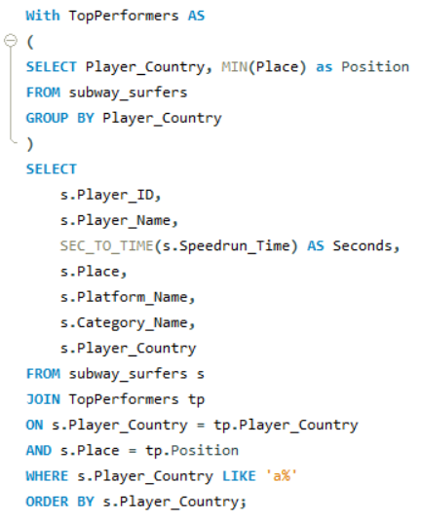
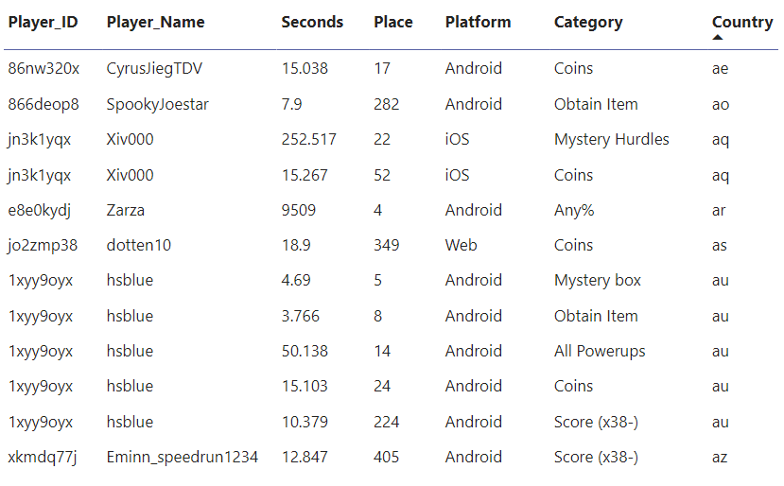
8) Identify the top performers for each country whose name starts with ‘a’.

Slide 13
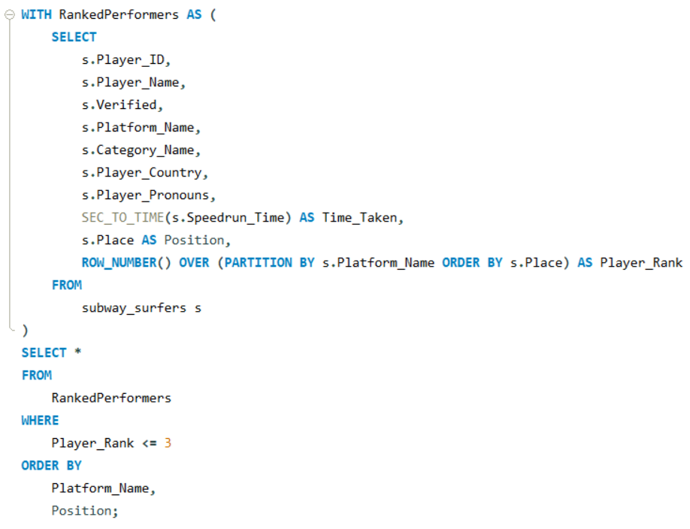

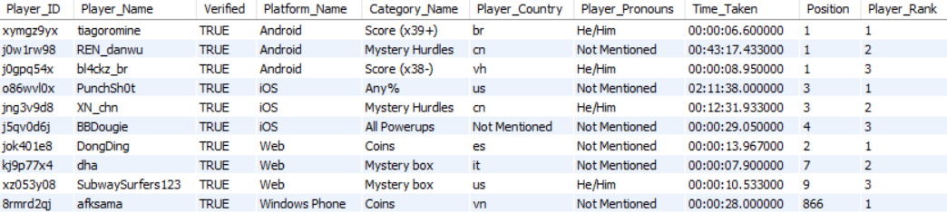
9) Identify the top 3 performers for each platform.

Slide 14
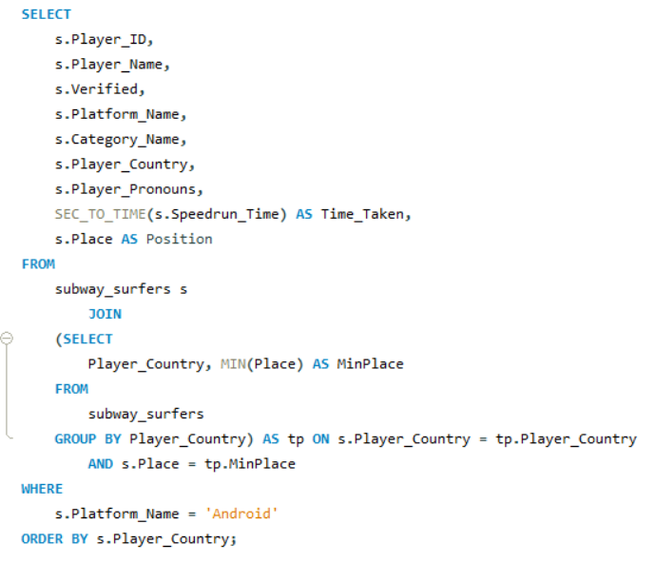

10) Identify the top performers for each country whose platform is ‘Android’.

Slide 15
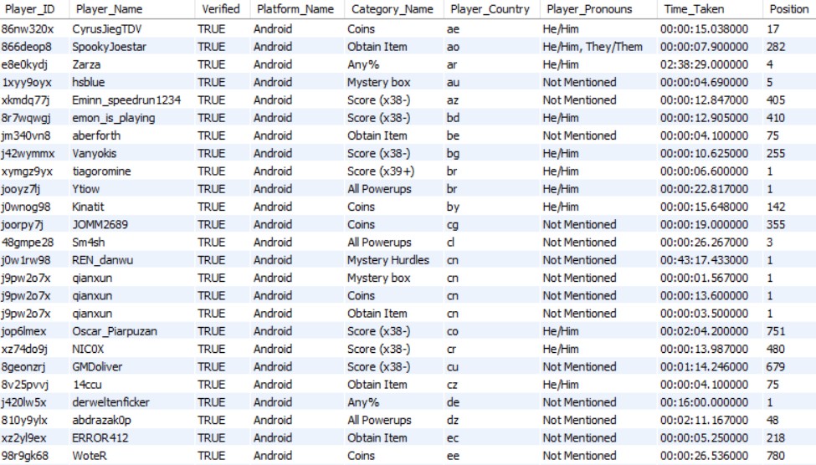

Slide 16

Thank You!

